Slide 1
Lecture1-2 Introduction (I)
Computer Organization and Architecture

Slide 2
Today’s Topic
0.0
Why Computer Organization & Architecture are important
Logistics & Disciplines
Brief History of Computer Architecture
Classification of Computers
What is Computer Organization & Architecture

Slide 3
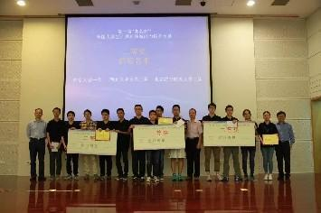
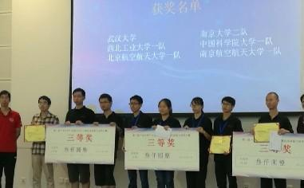
NSCSCC 2017
Fastest CPU in NSCSCC 2017
MIPS
92.6MHz in Xilinx Arty FPGA (with 40% IO delay Assumption)
3.712x Loongson Open Source CPU

Slide 4
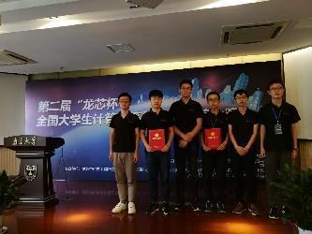
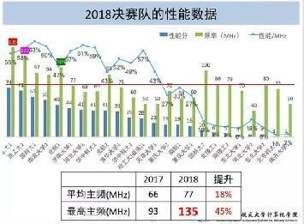
NSCSCC 2018
The fastest two CPUs in NSCSCC 2018
MIPS
135MHz/122MHz in Xilinx Arty FPGA
74.146x/70.679 Loongson Open Source CPU
“西工大队通过在关键路径上一点点细抠进行系统性能调优，特色明显。体现出他们对技术的精益求精的追求，对自己能力极致的挖掘，这是需要所有参赛选手应该追求的品质，是系统能力培养方面的重要方向”。
-----------刘卫东（清华大学教授，代表组委会的点评）

Slide 5
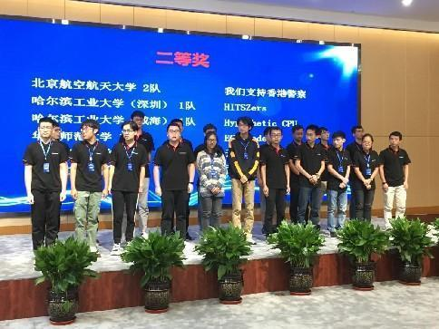
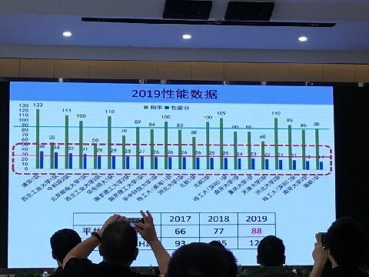
NSCSCC 2019
The first 4-way superscalar CPU in the competition
Out of Order Execution，Register Renaming、Branch Prediction，Write Buffer，。。。。。。
Notes:
我们神奇的地方就在于此，我们的主频只有清华的不到一半，但是性能几乎一样，这种技术优势，只有内行才能看出来；我们引领整个比赛的技术发展方向，每次我们参赛的技术，当年的比赛未必受到所有人的认可，但是在第二年都会成为大赛的主流技术。

Slide 6
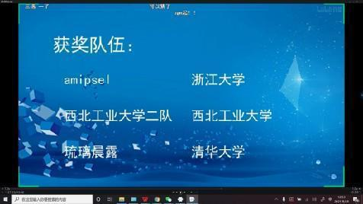
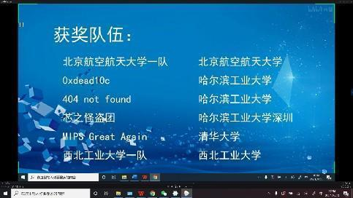
NSCSCC 2021
The fastest 3 CPUs in the Competition
Run at 155MHz, 150 MHz, and 145 MHz respectively.
Cache, MMU. Running Linux.
组委会的点评：“……对于这样复杂度的设计，150多MHz的主频已接近于组委会提供的硬件平台的极限。”

Slide 7
NSCSCC 2022
The fastest 3 CPUs in the Competition
Run at 155MHz, 150 MHz, and 145 MHz respectively.
9 Students achieved the individual award.
组委会点评：…近年来，各支参赛队形成了自己的风格，比如西工大代表队一直在电路优化方面努力，工作主频不断提高，就如“天下武功，唯快不破”…

Slide 8
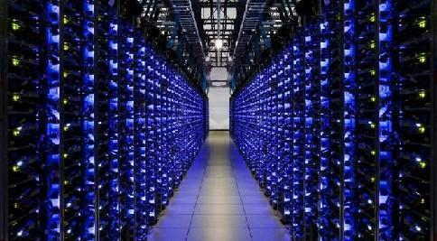
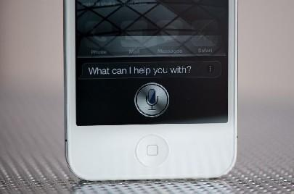
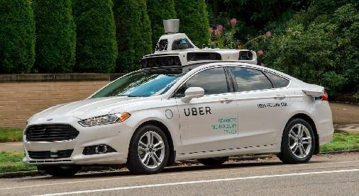
Why Computer Organization & Arch
1.0
Image credits: uber, extremetech, anandtech

Slide 9
Why Computer Organization & Arch
1.0
Embarrassing if you are a BS in CS/CE and can’t make sense of the following terms: DRAM, pipelining,cache hierarchies, I/O, virtual memory, …
Embarrassing if you are a BS in CS/CE and can’t decide which processor to buy: 3.0 GHz 2-core KabyLake or 3.6 GHz 8-core Zen (helps us reason about performance/power), …
Obvious first step for chip designers, compiler/OS writers
Will knowledge of the hardware help you write better programs?

Slide 10
1.1
Programmers‘ Essential About Hardware?
Must know how to evaluate program performance and energy
Memory management: if we understand how/where data is placed, we can help ensure that relevant data is nearby
Thread management: if we understand how threads interact, we can write smarter multi-threaded programs
→ Why do we care about multi-threaded programs?

Slide 11
Example
1.1
200x speedup for matrix vector multiplication
Data level parallelism(DLP, SIMD): 3.8x (Ch. 3)
Loop unrolling and out-of-order execution， Instruction Level Parallelism(ILP):2.3x (Ch.4)
Cache blocking, Memory Hierarchy Optimization: 2.5x (Ch. 5)
Thread Level Parallelism, parallel for loops in Multicore systems: 14x (Ch. 6)
Further, can use accelerators to get an additional 100x.

Slide 12
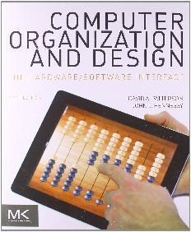
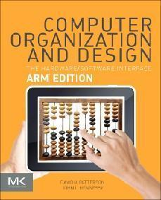
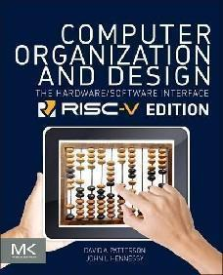
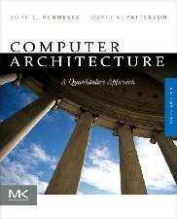
Logistics & Disciplines
2.0
Instructor: Jianfeng An, Meng Zhang and Danghui Wang anjf, zhangm, wangdh@nwpu.edu.cn Room 440/411/436 CS Building
Books:
Textbooks: “Computer Organization and Design” ,the 6th Edition, Patterson and Hennessy, 2013
Chinese Version, Translated by Danghui Wang, Jichang Kang and Jianfeng An, 2022
Reference: “Computer Architecture: A Quantitative Approach”, the 5th Edition, Hennessy and Patterson,2011
Computer Organization, Shuofei Tang
Slides: English
Grading Information
Homework and attendance: 30%
Final Exam:70%
Extra bonus:?

Slide 13
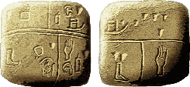
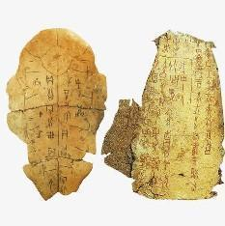
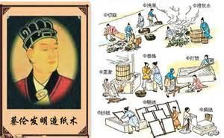
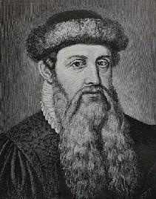

Brief History of IT (Information Tech)
3.0
Invention of writing, Sumer,
3500 B.C.
Oracle Characters, China, ~3000 years ago
Papermaking, Lun Cai,
China, 2nd Century
Typography, Sheng Bi, China,
Mid 11th Century
Modern movable type printing, Johannes
Gutenberg, Germany,
Mid 15th Century

Slide 14
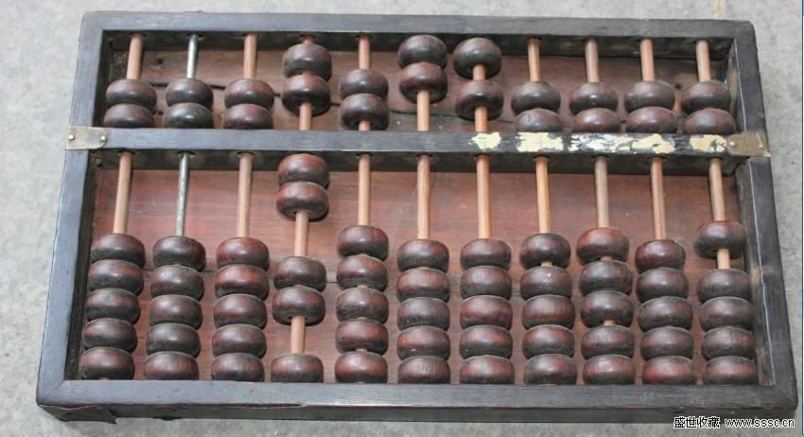
Brief History of IT (Information Tech)
3.0
Abacus，~500 B.C.，China

Slide 15
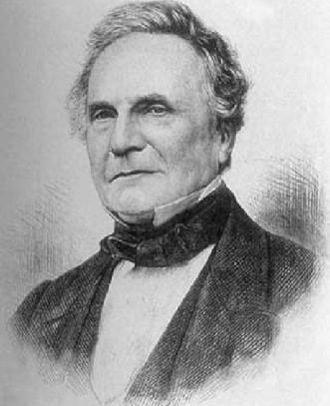
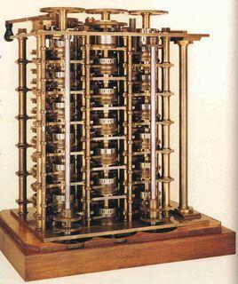
Brief History of IT (Information Tech)
3
Difference Engine，Charles Babbage，1832

Slide 16
Brief History of IT –Difference Engine
3.0
A machine to compute mathematical tables
Any continuous function can be approximated by a polynomial
Any polynomial can be computed from difference tables
Mechanical Registers
Steam engine drived output
3-order polynomial ，15 decimal digital

Slide 17
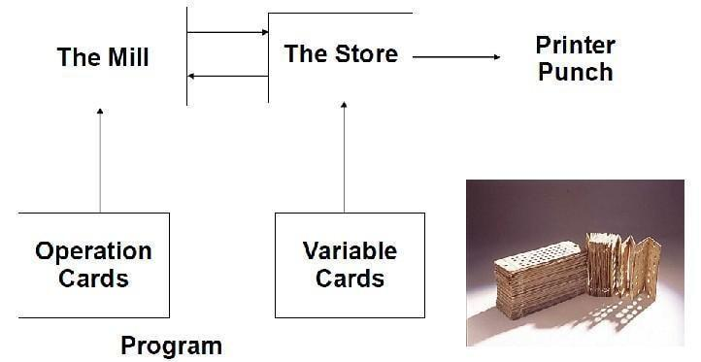
Brief History of IT – Analytical Engine
3.0
1834，Babbage

Slide 18
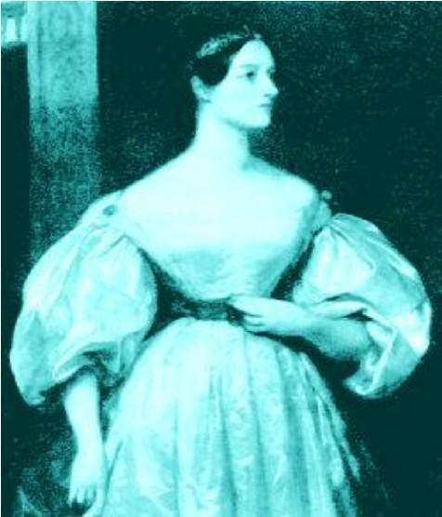
Brief History of IT-The first programmer
3.0
Ada Byron，1815-1852

Slide 19
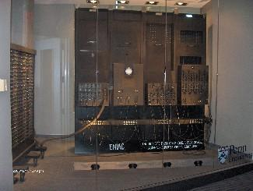
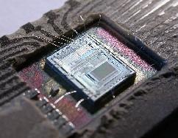

Brief History of IT (Information Tech)
3.0
John Mauchly, J. Presper Eckert and Von Neumann ENIAC
Micro Processor leverages Computing
Everything is online

Slide 20
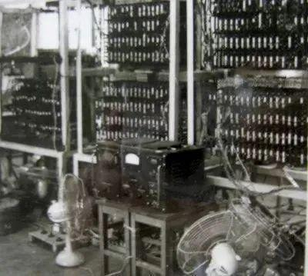
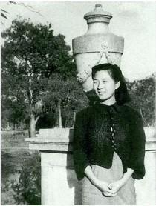
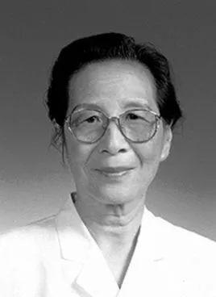
Brief History of Chinese Compt. Tech.
3.0
107 General Purpose Digital Computer
1960.04
Professor Peisu Xia(9123.07.28-2014.08.27）

Slide 21
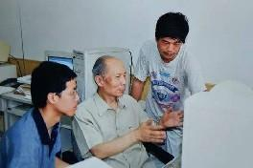
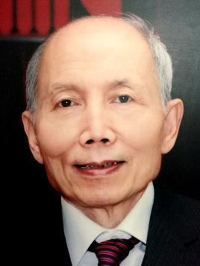
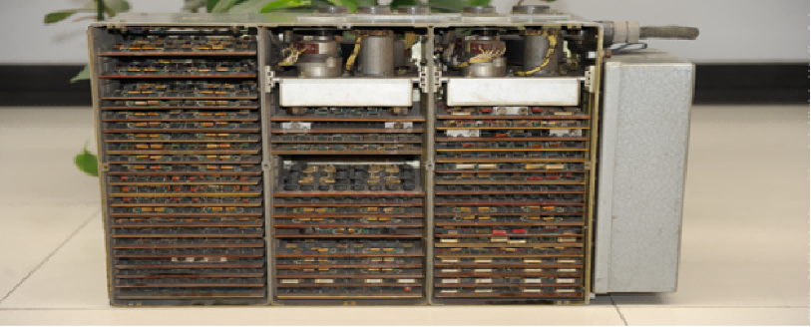
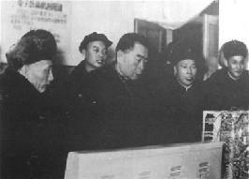
Brief History of Chinese Compt. Tech.
3.0
114 Computer（SSS-1型数字式射击瞄准计算机）
1974.12
我国第一台机载火控计算机
Professor Jichang Kang(1930.03.14-2018.01.09）

Slide 22
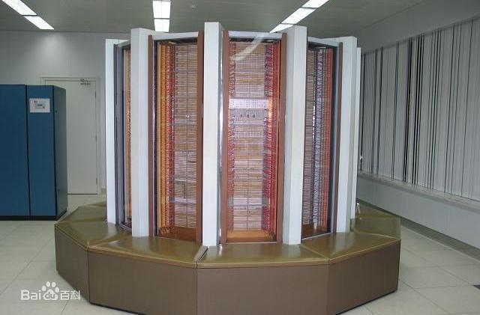
Brief History of Chinese Compt. Tech.
3.0
Galaxy-1
The First Supercomputer whose performance is 100 + MOPS
1983.12.22

Slide 23
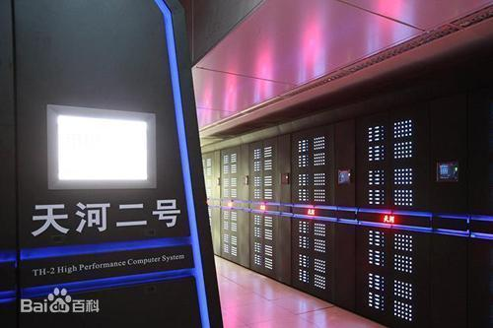
Brief History of Chinese Compt. Tech.
3.0
Tianhe-2（Milyway-2）
2013~2016：The fastest supercomputer in the world
国防科技大学

Slide 24
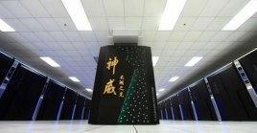
Brief History of Chinese Compt. Tech.
3.0
Sunway TaihuLight
2017：The fastest supercomputer in the world
国家并行计算机工程技术研究中心

Slide 25
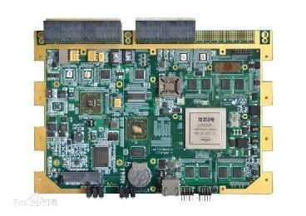
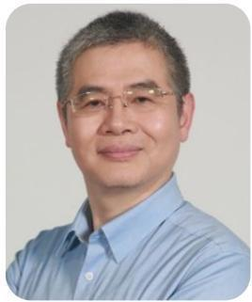
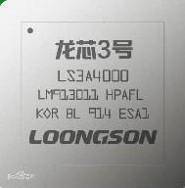
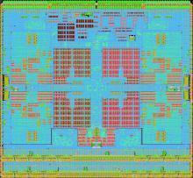
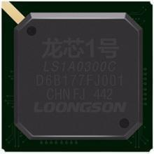
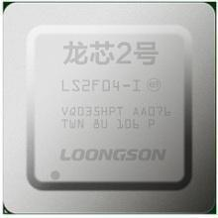
Brief History of Chinese Compt. Tech.
3.0
Loongson CPU
Prof. Weiwu Hu

Slide 26
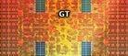
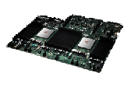
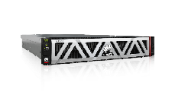


Brief History of Chinese Compt. Tech
3.0
鲲鹏---华为
鲲鹏是SoC
鲲鹏是计算平台
CPU Die
CPU Die
I/O Die
处理器->单机->集群，鲲鹏开放硬件平台
鲲鹏开放主板
鲲鹏服务器
制程工艺领先：业界领先7nm制程，
多Die合封的Chiplet架构
自研多核内核：自研CPU内核算力提升50%，自研片间互联，支持多路互联
率先支持下一代网络和接口：支持8通道内存控制器和100GE端口
完备的软件工具链，发挥鲲鹏最佳性能
分析扫描工具
代码迁移工具
性能优化工具
加速库

Slide 27
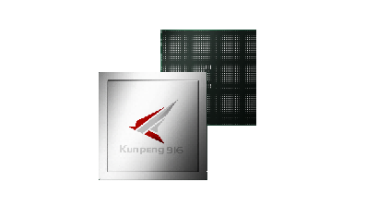
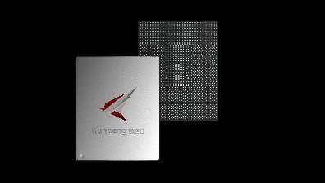
Brief History of Chinese Compt. Tech
3.0
华为“鲲鹏”处理器
鲲鹏916
鲲鹏920
支持多路互联的ARM处理器
7nm制程，数据中心ARM处理器
32核，2.4 GHz主频
SPECint性能匹配业界中端，功耗低至75 W
支持4通道DDR4控制器
支持PCIe 3.0和SAS/SATA 3.0
集成板载GE/10 GE网络
支持2路互联
计算核数提升1倍，最多64核
SPECint性能提升超过2倍
内存通道数提升1倍，支持8通道DDR4控制器
支持PCIe 4.0和CCIX
集成板载100 GE网络和加密、压缩等引擎
支持2路或4路互联

Slide 28
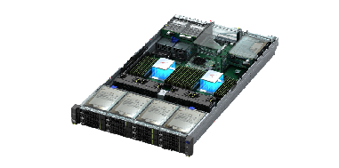
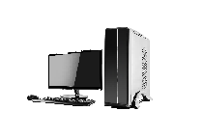
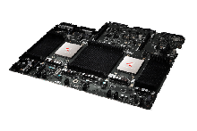

Brief History of Chinese Compt. Tech
3.0
基于鲲鹏主板的多样化计算产品
鲲鹏主板开放
共享接口与设备规范
整机参考设计
共享工程能力
打造多样化计算产品
PC
服务器
主板(含鲲鹏处理器)
主板接口规范
BIOS软件 & 规范
BMC芯片/软件 & 设备管理规范
整机参考设计指南
(含机箱、散热、供电等设计)
部件与OS兼容性列表

Slide 29








Brief History of Chinese Compt. Tech
3.0
17年的工程工艺积累
40度以上异常高温运行
无源背板&三重硬盘抗震
液冷
散热
高速互联
可靠
设计
质量品控
56G/112G板级高速互联
故障率低于业界15%
数据中心
存储密集型
计算密集型
5290
4U72盘存储型
5280
4U40盘存储型
2280
2U2路均衡型
1280
1U2路高密型
2480
2U4路高性能型
X6000
2U4节点高密型
(新产品)
(新产品)
(新产品)

Slide 30










Brief History of Chinese Compt. Tech.
3.0
Tsinghua University
Northwestern Polytechincal University
航空计算技术研究所
北京航天微电子技术研究所
……

Slide 31



2 Great Inventions of IT
3.1
ENIAC (Electronic Numerical Integrator and Computer, Feb 14, 1946)
Beginning of computers as a main role in IT Roadmap
Transistor (1946) and IC (1957)
Moore’s Law is the observation that the number of transistors in a dense integrated circuit doubles approximately every two years.
Memory Size
Processor Integrations
Communication Bandwidth of Computer
Glen Beck (background) and Betty Snyder(foreground) program ENIAC in BRL building 328. (U.S. Army photo)
Photo of (from left) J. Bardeen, W. Shockley and W. Brattain, the inventors of the transistor, 1948.
Jack Kilby's original integrated circuit (IC)
Notes:
Betty Snyder, one of the original programmer of ENIAC.
Actually, the first IC was designed by Jack Kilby in TI’s lab. However, as the business consideration, applying patent, the Lab leader kept it as a TI’s top secret, which also kept Jack Kilby’s Noble till 1970’s for his JK FlipFlop.

Slide 32

Information Tech
3.1
Information Theory
Eg. Nyquist–Shannon sampling theorem
Computing Theory
Eg. Turing Machine
Von Neumann Structure
IT
(Information Technology)

Slide 33
Dematerialization of Human Society
3.2
Human Civilization has been dematerialized via Cyberization Tech
Terminology
ops, bytes, bits/second(bps), pixels, and sensors/actuators
Media began to be changed into electrons, magnetics and photons held in semiconductors from Atoms
Cyberization Tech
Bridge the gap between Atoms of material and electrons, photons even quantum

Slide 34
The Computer Revolution
3.3
Progress in computer technology
Underpinned by Moore’s Law
Makes novel applications feasible
Computers in automobiles
Cell phones
Human genome project
World Wide Web
Search Engines
Computers are pervasive

Slide 35
Information Data Storage
3.3
If we can live a 120-year life (wish to every one), the information we read (write), speak (listen) and see could be:
Data Type | Per Hour | Per Day (Per 4-year) | Whole life of person
Reading Lecture | 200K | 2-10M(G) | 60-300G
Speaking (120 wpm) | 43K | 0.5M(G) | 15G
Audio (1KBps) | 3.6M | 40M(G) | 1.2T
POTS Video (50Kbps) | 22M | .25G(T) | 7.5T
VHS (200Kbps) | 90M | 1G(T) | 30T
HDTV (4.3Mbps) | 1.8G | 20G(T) | Less 1P
Notes:
POTS: Plain Old Telephone Servicing
POTS is characterized by several aspects:
Bi-directional (full duplex) communications.
Using balanced signaling of voltage analogs of sound pressure waves on a two-wire copper loops
Restricted to a narrow frequency range of 300 to 3300 Hz, called the voiceband, which is much less than the human hearing range of 20 - 20,000 Hz
Call-progress tones, such as dial tone and ringback tone.
Dial pulse signaling of addresses.
BORSCHT functions.
VHS: Video Home System (Lu Xiang Dai)

Slide 36
Computer Systems Classification
4.0
Three general classes of “Computer”
Desktop Computers
Servers
Embedded Computers

Slide 37
Computer Systems-Desktop Computers
4.1
Examples include PC, Mac, Chrome, Linux…
Notebooks, netbooks, tablets (smart phones), …
Interact with users – applications
Handful of central processing units (4-12 CPUs), gigabytes (10⁹ bytes) memory,
Few terabytes (10¹² bytes) of disk
35 gigaflops (35×10⁹ “floating-point math calculations” per second for Intel Ivy Bridge)

Slide 38
Computer Systems-Servers
4.2
Web servers, Computational servers, Supercomputers
Interact with other computers to “solve a problem” or “provide services”
Dozens to thousands of CPUs (Tianhe-2: 3,120,000 CPUs, 33.9 petaflops, or 33.9×10¹⁵ calculations per second vs. 35×10⁹ for PC)
Gigabytes to terabytes memory (Sequoia: 1,024,000GB [1.0 petabyte!])
Petabytes (10¹⁵ bytes) of storage
Connected (network) to work together
Power hungry but efficient (Tianhe-2: 17.8 MW vs. Three Mile Island ~800 MW output). Data centers: 1.7% to 2.2% of total electricity in US.)

Slide 39
Computer Systems-Embedded Computers
4.3
Hidden inside something not computer
Applications that run on these computers interact with the “real world”
Multiple different processors for different functions
Kilobytes (10³ bytes) to gigabytes of memory
Kilobytes to gigabytes of storage
Slow speed to fast speed
Widest range of design!

Slide 40

The PostPC Era
4.4

Slide 41
The PostPC Era
4.4
Personal Mobile Device (PMD)
Battery operated
Connects to the Internet
Hundreds of dollars
Smart phones, tablets, electronic glasses
Cloud computing
Warehouse Scale Computers (WSC)
Software as a Service (SaaS)
Portion of software run on a PMD and a portion run in the Cloud
Amazon and Google

Slide 42

Computer systems: Commonality
4.5
Programmable: Software programs “run” on the hardware
Components
Central processing unit (CPU): Does the computation
A.k.a., “the processor”, “the core”
Main memory: Temporarily holds results (volatile)
Storage: Long term storage for large quantities
Input/Output: Interaction (human, physical world or machine)

Slide 43

Computer systems: Commonality
4.5
Von Neumann Machine
Memory: Storage of information (data/program)
Processing Unit: Computation/Processing of Information
Input: Means of getting information into the computer
Output: Means of getting information out of the computer
Control Unit: Makes sure that all the other parts perform their tasks correctly and at the correct time.

Slide 44
Computer systems: Commonality(Con.)
4.5
Metrics
Speed: How fast computation is done. Faster is not always necessarily better. Usually some constraint/goal on speed.
Energy/Power: A BIG concern today! Battery. Electricity cost and delivery to data center

Slide 45
Why Computer Organization and Arch?
5.0
Why?
A few people design processors/systems
More people program on computers
Every people uses computers!
The more you learn about the computer Organization and architecture, the higher efficiency you can achieve!

Slide 46
Example-1
5.0
How to select a proper processor?
What are your concerns?
Price?
Performance?
Reliability?
CPU, Memory, Storage, GPU?
…
Notes:
Core number
Frequency
ISA
Cache
Memory
I/O

Slide 47
Example-2
5.0
Map reduce programming
System-1: 10 Xeon processors
System-2: 80 ARM processors
System-3: 10 Xeon + 80 ARM ??
Needs programming for system configuration

Slide 48
What is Computer Arch
5.0
Broadest Definition
Computer Architecture is the design the abstraction layers that allow us to implement information processing applications efficiently using available manufacturing technologies.
Application
Gap too Large to bridge in one single step
Physics

Slide 49

Levels of Transformation
5.1
“The purpose of computing is insight” (Richard Hamming)
We gain and generate insight by solving problems
How do we ensure problems are solved by electrons?
Problem
Algorithm
Program/Language
Runtime System
(VM, OS, MM)
ISA (Architecture)
Microarchitecture
Logic
Circuits
Electrons
Notes:
ISA is the interface between hardware and software… It is a contract that the hardware promises to satisfy.
Algorithm: step by step procedure where each step is effectively computable (by a computer), is definite (precisely defined) – “do until fast” is not definite, and terminates
Hamming distance: number of locations in which the corresponding symbols of two equal-length strings is different
Hamming, Richard W. (1950), "Error detecting and error correcting codes", Bell System Technical Journal 29 (2): 147–160
Hamming codes

Slide 50
Aside: Papers By Hamming
5.1
Hamming, “Error Detecting and Error Correcting Codes,” Bell System Technical Journal 1950.
Introduced the concept of Hamming distance
number of locations in which the corresponding symbols of two equal-length strings is different
Developed a theory of codes used for error detection and correction
Also:
Hamming, “You and Your Research,” Talk at Bell Labs, 1986.
http://www.cs.virginia.edu/~robins/YouAndYourResearch.html

Slide 51
The Power of Abstraction
5.1
Levels of transformation create abstractions
Abstraction: A higher level only needs to know about the interface to the lower level, not how the lower level is implemented
E.g., high-level language programmer does not really need to know what the ISA is and how a computer executes instructions
Abstraction improves productivity
No need to worry about decisions made in underlying levels
E.g., programming in Java vs. C vs. assembly vs. binary vs. by specifying control signals of each transistor every cycle
Then, why would you want to know what goes on underneath or above?

Slide 52
Crossing the Abstraction Layers
5.1
As long as everything goes well, not knowing what happens in the underlying level (or above) is not a problem.
What if
The program you wrote is running slow?
The program you wrote does not run correctly?
The program you wrote consumes too much energy?
What if
The hardware you designed is too hard to program?
The hardware you designed is too slow because it does not provide the right primitives to the software?
What if
You want to design a much more efficient and higher performance system?

Slide 53
How Do the Pieces Fit Together?
5.1
Application
Operating
S/W
System
Compiler
Firmware
Instruction Set
Architecture
Memory
system
Instr. Set Proc.
I/O system
Datapath & Control
H/W
Digital Design
Circuit Design
Electron
Coordination of many levels of abstraction
Under a rapidly changing set of forces
Design, measurement, and evaluation
Notes:
For lecture

Slide 54

What is ISA
5.2
I speak Spanish to God, Italian to women, French to men, and German to my horse.
Charles V, Holy Roman Emperor
(1500–1558)
… the portion of the machine visible to the programmer or compiler writer.
Hennessey and Patterson, 1990

Slide 55
The Instruction Set: a Critical Interface
5.2
software
instruction set
hardware

Slide 56
ISA & Computer Arch
5.2
By the architecture of a system, I mean the complete and detailed specification of the user interface. … As Blaauw has said, “Where architecture tells what happens, implementation tells how it is made to happen.”
The Mythical Man-Month, Brooks, pg 45
Computer Architecture = Instruction Set Architecture
+Machine Organization + …

Slide 57
Levels of Representation
5.2
temp = v[k];
v[k] = v[k+1];
v[k+1] = temp;
High Level Language Program
Compiler
lw $15, 0($2)
lw $16, 4($2)
sw $16, 0($2)
sw $15, 4($2)
Assembly Language Program
Assembler
0000 1001 1100 0110 1010 1111 0101 1000
1010 1111 0101 1000 0000 1001 1100 0110
1100 0110 1010 1111 0101 1000 0000 1001
0101 1000 0000 1001 1100 0110 1010 1111
Machine Language Program
Machine Interpretation
Control Signal Specification
ALUOP[0:3] <= InstReg[9:11] & MASK

Slide 58
Instruction Set Architecture
5.2
… the attributes of a (computing) system as seen by the programmer, i.e. the conceptual structure and functional behavior, as distinct from the organization of the data flows and controls the logic design, and the physical implementation.
Amdahl, Blaauw, and Brooks, 1964
SOFTWARE
-- Organization of Programmable
Storage
-- Data Types & Data Structures:
Encodings & Representations
-- Instruction Formats
-- Instruction (or Operation Code) Set
-- Modes of Addressing and Accessing Data Items and Instructions
-- Exceptional Conditions

Slide 59
Computer Arch Contents
5.2
1950~1960s: Computer Arithmetic Logic Design
1970~1980s: Computer Instruction Set Arch Design
1990s: Computer Arch with multi sub-fields (e.g. Processor, Memory sys, I/O sys, Multi-processor, Networks, etc.)
Now: Extended Wilder and Deeper (e.g. Many(multi)-core processor, Hierarchical Memory, Fast I/O, Parallel processing, Network, SoC, Cloud Computing, DSA, etc.)

Slide 60
Computer Arch Continually Changing
5.2
Applications suggest how to improve technology, provide revenue to fund development
Applications
Improved technologies make new applications possible
Technology
Compatibility
Cost of Software development makes compatibility a major force in market

Slide 61
Definition of ISA
5.2
Instruction set architecture (ISA), is the part of the computer architecture related to programming, including the native data types, instructions, registers, addressing modes, memory architecture, interrupt and exception handling, and external I/O.
An ISA includes a specification of the set of opcodes (machine language), and the native commands implemented by a particular processor.

Slide 62
Hardware/Software Interface: It Changes
5.2
The line between hardware and software becomes somewhat fuzzy when last year’s software is embedded directly [for example] in read-only memory on a memory management chip where it is invisibly invoked by the programs being managed.
Harold Stone, 1987
DEC Alpha v1, v3 1992-97
HP PA-RISC v1.1, V2.0 1986-96
Sun Sparc v8, v9 1987-95
SGI MIPS MIPS I, II, III, IV, V 1986-96
Intel 8086, 80286, 80386, 1976-2013 80486, MMX, SSE, SSE2, SSE3, SSE4, x86-64, AVX, AES, AVX2&FMA, IA-64…

Slide 63
Computer Organization
5.3
The function and performance of the main units
Registers, ALU, Shifter, Logic Unit, etc.
Interconnect among units
Communication among Units
Logic to control these information flows
Cooperating and running of functional units, in order to implement ISA.
Touch Register Transfer Level (RTL) Somehow!
Recall Digital Circuit Design Please !!
From the view of Logic Design
ISA
Fun Units & Interconnect
SOFTWARE

Slide 64




Computer Organization
5.3
Teardown happens in geeks’ life
RED = Apple APL1012 A8X 64-bit Processor ORANGE = Elpida (Micron Technology) F8164A3MD (two identical chips) YELLOW = SK Hynix H2JTDG8UD1BMR 128 Gb (16 GB) NAND Flash GREEN = NXP 65V10 NFC Module (as found in the iPhone 6 and 6 Plus) BLUE = Apple (Cirrus Logic) 338S1213 Audio Codec PURPLE = NXP Semiconductors LPC18B1UK ARM Cortex-M3 Microcontroller (Apple M8 Motion Co-Processor)
Notes:
Tear the top glass panel off
Wifi Antennas
Touch ID biometric sensor
Speakers
Battery
Mainboard

Slide 65


Computer Organization
Inside of Apple A8X

Slide 66

Organization of Pentium 4
5.3

Slide 67

Microarchitecture of Pentium 4
5.3

Slide 68
Curriculum Subject
5.4
Computer Scientist and Engineer should know intrinsic characters of computer
Why?
Only few people design computer
Everyone works with computer
Knows more, works more efficiently
User-centered Computer System
How to inspire users and be inspired by users
Systematic consideration: Processer, Memory, I/O, Memory System, Network…
Benefits
Design a faster program or design a program faster
Chose hardware for specific APP.
Know trends of tech (structure)

Slide 69

Curriculum Subject
5.4
Architecture Bridges from EE to CS
What are the application requirements?
What features are required to support OS?
What features can optimizing compilers use?
What hardware can I build?
What hardware can I build next year?
Computer Arch must be broad!

Slide 70
Overview of Physical Implementations
5.5
The hardware out of which we makes systems.
Integrated Circuits (ICs)
Combinational Logic Circuits, Memory Elements, analog Interfaces
Printed Circuits (PC) Boards
Substrate for ICs and Interconnections, Distribution of CLK, Vdd, and GND Signals, Heat Dissipation.
Power Supplies
Converts Line AC voltage to regulated DC low voltage levels.
Chassis (Rack, Card Case, …)
Holds Boards, Power Supply, Provides Physical Interface to user or other systems
Connectors and Cables

Slide 71




Integrated Circuits
5.5
Silicon Chips
1mm-25mm on a side
Feature size ~14nm =14x10⁻⁹m (2016)
Max10B transistors
More than 10 metal layers
CMOS (Complementary Metal Oxide Semiconductor) -most common
Package Provides:
Bonding wires from chip to board (signal paths)
heat dissipation
Ceramic or plastic (strengthening with metal for military standard) with gold wires
Notes:
ProcessorTransistor countDate of introductionDesignerProcessArea
Intel 40042,3001971Intel10,000 nm12 mm²
Intel 80083,5001972Intel10,000 nm14 mm²
Intel 80804,5001974Intel6,000 nm20 mm²
IBM z13 Storage Controller7,100,000,0002015IBM22 nm678 mm²
IBM z133,990,000,0002015IBM22 nm678 mm²
Quad-core + GPU GT2 Core i7 Skylake K1,750,000,0002015Intel14 nm122 mm²
Duo-core + GPU Iris Core i7 Broadwell-U1,900,000,000^{[23]}2015Intel14 nm133 mm²
SPARC M710,000,000,000^{[33]}2015Oracle20 nm
Apple A10 (quad-core ARM64 "mobile SoC")3,300,000,0002016Apple16 FFC125 mm²
22-core Xeon Broadwell-E57,200,000,000^{[32]}2016Intel14 nm456 mm²

Slide 72

Printed Circuit Boards
5.5
FR-4 Glass Epoxy
1-20 conductive layers
IC packages are soldered down
Provides:
Mechanical support
Distribution of power and heat

Slide 73

Moore’s Law & Others
5.6
Moore’s law
However it dying or has been dead.
Intel Cannonlake and 10nm are still planned but are not due until the second half of 2017
Gordon Moore's original graph, showing projected transistor counts, long before the term "Moore's law" was coined.

Slide 74


Moore’s Law & Others
5.6
Gordon Moore
Intel Cofounder
2x Transistors /Chip Every 1.5 years
Called “Moore’s Law”

Slide 75

Moore’s Law & Others
5.6
Moore’s Law
Gordon Moore
Intel Cofounder

Slide 76

Moore’s Law & Others
5.6
Year Size
1980 0.0625Mbit
1983 0.25Mbit
1986 1Mbit
1989 4Mbit
1992 16Mbit
1996 64Mbit
1998 128Mbit
2000 256Mbit
2002 512Mbit
2004 1Gbit
2006 2Gbit
2009 4Gbit
…
2014 12Gbit
2016 16Gbit
Memory Capacity (Single-Chip DRAM)
1.4X/yr, → 2X every 2 yrs → Much Lower Now (12Gbit to 16Gbit LPDDR4 takes 14 months in Samsung)
80XX since 1980!
Programmer interested on small memory optimization, 30 years ago.

Slide 77

Moore’s Law & Others
5.6
35 years of Microprocessor Trend
Single-thread Performance trend changes
VAX: 1.25x/y 1978 to 1986
RISC+x86: 1.52x/y 1986 to 2002
RISC+x86: 1.20x/y 2002 to 2006
Single-thread Performance growth keeps slowing down now
Programmer interests on parallelism NOW
no mater in PMD, Cloud Computing, or SaaS.

Slide 78

Moore’s Law & Others
5.6
Energy Efficiency
Surging demand for new products and the continuing existence of inefficient products will drive energy use up
Increased energy use is raising energy costs and causing haze weather.
Energy efficiency will drive demand for new products

Slide 79
Moore’s Law & Others
5.6
Computer Technology – Dramatic Changes!
Memory
DRAM Capacity: 2x / 2 years (since 1996)
64x size improvement in last decade
Processor
Speed 2x / 1.5 years (since 1985) [slowing down]
100x performance in last decade
Disk
Capacity: 2x / year (since 1997)
250x size in last decade

Slide 80
Moore’s Law & Others
5.6
Computer Technology – Dramatic Changes!
State-of-the-art PC when you graduate:
Processor clock speed: 4,000 Mega Hertz (4.0 Giga Hertz)
Memory capacity: 65,536 Mebi Bytes (64.0 Gibi Bytes)
Disk Capacity: 4,000 Giga Bytes (4.0 Tera Bytes)
Units! Mega => Giga, Giga => Tera (Tera => Peta, Peta => Exa, Exa => Zetta, Zetta => Yotta = 10²⁴)
You just learned the difference between (Kilo, Mega, …) and (Kibi, Mebi, …)!

Slide 81
Moore’s Law & Others
5.6
A new class emerges and some die every decade.
Bell’s Law of Computer Classes
Decades | Minimum Price | Features
60s | $millions | Mainframes Computers
70s | $10K-100K | Minicomputer
80s | $10K | Workstations & PCs
90s | $1K | Internet PCs
00s | $100s | PDA, Cell Phones
10s | $10 | Tablets, Clouds, Wearable,…
?? | ? | Carbon, DNA, Quantum, Bio?
New Computer → New Applications → Emerging Industries

Slide 82

Moore’s Law & Others
5.6
A new class emerges and some die every decade.
Bell’s Law of Computer Classes
New Computer →
New Applications →
Emerging Industries

Slide 83

Moore’s Law & Others
5.6
Software is a gas!
It expands to fit the container it is in!
Nathan’s 1st Law of Sftware (ACM97)

Slide 84
Moore’s Law & Others
5.6
Software grows until it becomes limited by Moore’s Law
Nathan’s 2nd Law of Sftware (ACM97)
Initial growth is rapid – like gas expanding (like browser)
Eventually, limited by hardware (like NT)
Bring any processor to its knees, just before the new model is out

Slide 85
Moore’s Law & Others
5.6
Software growth makes Moore’s Law possible
Nathan’s 3rd Law of Sftware (ACM97)
That’s why people buy new hardware – economic motivator
That’s why chips get faster at same price, instead of cheaper
Will continue as long as there is opportunity for new software

Slide 86
Moore’s Law Goes with Software
Hardware update, driven by the requirement of New Software
Processor price keeps steady, no Inc, no Dec, however performance improved.
If software companies stop updating, the hungering of processor performance will be stop.

Slide 87
Moore’s Law & Others
5.6
Software is only limited by human ambition & expectation
Nathan’s 4th Law of Software (ACM97)
It’s impossible to have enough for human
Socrates said He who is not contented with what he has, would not be contented with what he would like to have.
New algorithms
New applications and new users
New notions of what is cool

Slide 88
What happened in last 3-decade
Performance
Improvement of Fabrication Technology
CMOS VLSI outperformances Old-Tech (TTL, ECL)
Improvement of Computer Architecture
RISC, Superscalar, RAID, etc.
Leverage Low-end Products
ARM, MCU

Slide 89

Measurement & Evaluation
Architecture Study follows the iterations
The Iteration happens in any hierarchic levels
Design Space Exploration happens in any design corner.
Design
Analyze
Creativity
Design Space
Cost/Perfor-mance
Design Space
Convergence
Bad Idea
Not that Bad
Good Idea

Slide 90
Content Structure
Computer Organization & Architecture
ISA & System Design
Interfaces
from the view of compiler /System
“Building Architect”
Computer Organization
Hardware
from the view of logical designer
“Construction Engineer”

Slide 91
Content Structure – more Secular & Utility
Computer Organization & Architecture
ISA & System Design
Interfaces
Machine Language
From the view of compiler /System
Computer Architecture
Instruction System & Processor
“Building Architect”
Computer Organization
Hardware
Machine Implementation
From the view of logical designer
Architecture of Processor
Computer Organization
“Construction Engineer”
Little amount of people work with Computer Design! Much less with ISA Design!
Large amount of people work with Computer Components Design…
Much more care about the detailed Functionality of Computer…

Slide 92
Content levels
Diagram of Representations
temp = v[k];
v[k] = v[k+1];
v[k+1] = temp;
High Level Language Program
Compiler
Assembly Language Program
lw $15, 0($2)
lw $16, 4($2)
sw $16, 0($2)
sw $15, 4($2)
Assembler
Machine Language Program
0000 1001 1100 0110 1010 1111 0101 1000
1010 1111 0101 1000 0000 1001 1100 0110
1100 0110 1010 1111 0101 1000 0000 1001
0101 1000 0000 1001 1100 0110 1010 1111
Machine Interpretation
Control Signal Specification
ALUOP[0:3] <= InstReg[9:11] & MASK

Slide 93


Content levels
5.6
Diagram of Representations
temp = v[k];
v[k] = v[k+1];
v[k+1] = temp;
High Level Language Program
Compiler
Assembly Language Program
lw $15, 0($2)
lw $16, 4($2)
sw $16, 0($2)
sw $15, 4($2)
Assembler
Machine Language Program
0000 1001 1100 0110 1010 1111 0101 1000
1010 1111 0101 1000 0000 1001 1100 0110
1100 0110 1010 1111 0101 1000 0000 1001
0101 1000 0000 1001 1100 0110 1010 1111
Machine Interpretation
Hardware Arch Description
(e.g. block diagrams)
Control Signal
Specification
Logic Circuit Description
(e.g. Circuit Schematic)

Slide 94
Recall the First Example
5.6
200x speedup for matrix vector multiplication
Data level parallelism(DLP, SIMD): 3.8x (Ch. 3)
Loop unrolling and out-of-order execution， Instruction Level Parallelism(ILP):2.3x (Ch.4)
Cache blocking, Memory Hierarchy Optimization: 2.5x (Ch. 5)
Thread Level Parallelism, parallel for loops in Multicore systems: 14x (Ch. 6)
Further, can use accelerators to get an additional 100x.

Slide 95
Course Goal
Answer 7 Questions (Blue for S Designers, Red for H Designers)
How are programs translate into hardware language and how does it execute?
To build the concepts of program performance impacted by both S/H
What is the interface between Soft/Hardware and how software instruct hardware to perform functions?
To build understanding of writing many kinds of programs
What determines the performance of a program and how to improve it?
Effectiveness
What techniques can be used to improve performance?
Only basic concepts in this course, more advanced are on Computer Arch
What techniques can be used to improve energy efficiency? What can programmers do in energy efficiency?
What are reasons and consequences of parallelism?
Mainly multicore
What great ideas of computer architecture lay the foundation of modern computing

Slide 96
Course Goal
Understanding: Internal mechanism, developing features, and the trade-off, between Software and Hardware, of modern computer
Can observe which operation fast/slow, can also understand which implementation hard/easy in hardware
“Taste” the design flow via large, complicate (hardware) system
Know the flow
Function description => Control & Data Path => Transistor (Phisics)
Understand the concept of IC Design and CAD (Computer-aided Design)
Skill Tree of IT Designer

Slide 97
Skill Tree
Evaluation Techniques
Levels of Translation (e.g. compilation)
Levels of Interpretation (e.g. Microprogramming)
Hierarchy (e.g. registers, cache, mem, disk, tape)
Pipelining and Parallelism
Static/Dynamic Scheduling
Indirection and Address Translation
Synchronous and Asynchronous Control Transfer
Timing, Clocking, and Latching
Physical Design of Cells (e.g. CLA)
Understanding Technology and Foundary Developing
……
Notes:
评测技术
变换的级别
解释的级别
层次化
流水和并行
静态／动态调度
间址和地址变换
同步和异步传输
时序、时钟同步、锁存
单元的物理设计
技术工艺发展趋势

Slide 98
Summary Although Different with Textbook
6
Three general classes of “Computer”
Computer systems: Commonality
Computer Architecture: Abstraction
ISA
Computer Organization

Slide 99
Goal of CH. 1
Basic Idea and Definitions
1.1 ~ 1.2
Major components of software and hardware in perspective
1.3 ~ 1.4
How to evaluate performance and energy (next slides)
1.6 ~ 1.7, 1.9
IC Introduction (that fuels the computer revolutions, next slides, partially)
1.5
The shift to multicores
1.8

Slide 100
Reading Assignment
Extension Reading
1.12 Historical Perspective and Further Reading
Available online

